Slide 1

Cipher Chronicle
By Hardattsinh Mangrola
23CEB024

Slide 2
Cipher Chronicle is a secure and versatile personal diary management system designed to safeguard your confidential thoughts and memories. It goes beyond the conventional diary by incorporating encryption to ensure the privacy and security of your entries.
Let's delve into the intriguing features and purpose of Cipher Chronicle: Cipher Chronicle is a secure and versatile personal diary management system designed to safeguard your confidential thoughts and memories. It goes beyond the conventional diary by incorporating encryption to ensure the privacy and security of your entries. Let's delve into the intriguing features and purpose of Cipher Chronicle:

Slide 3
PURPOSE OF THE PROJECT
Privacy and Security:
Cipher Chronicle prioritizes the confidentiality of your personal thoughts, employing encryption to safeguard against unauthorized access.
Memory Preservation:
Chronicle your memories in a structured manner, creating a time capsule that reflects your thoughts and experiences over time.
Versatility and Accessibility:
The project provides a versatile platform accessible to users, combining the traditional charm of diary-keeping with modern security measures.
Learning and Exploration:
Cipher Chronicle offers a hands-on learning experience in secure coding practices, encryption techniques, and file handling within a C programming context.

Slide 4
FEATURES
Password-Protected Access
Entry Encryption
Structured Entries
Sorting Functionality
Entry Management
File Encryption
Cipher Chronicle offers a secure digital diary, ensuring user privacy with robust encryption and authentication. It merges traditional journaling with modern technology, making it a trustworthy space for personal reflection. Simultaneously, it serves as an educational tool, fostering an understanding of secure coding and data protection within the C programming language.

Slide 5
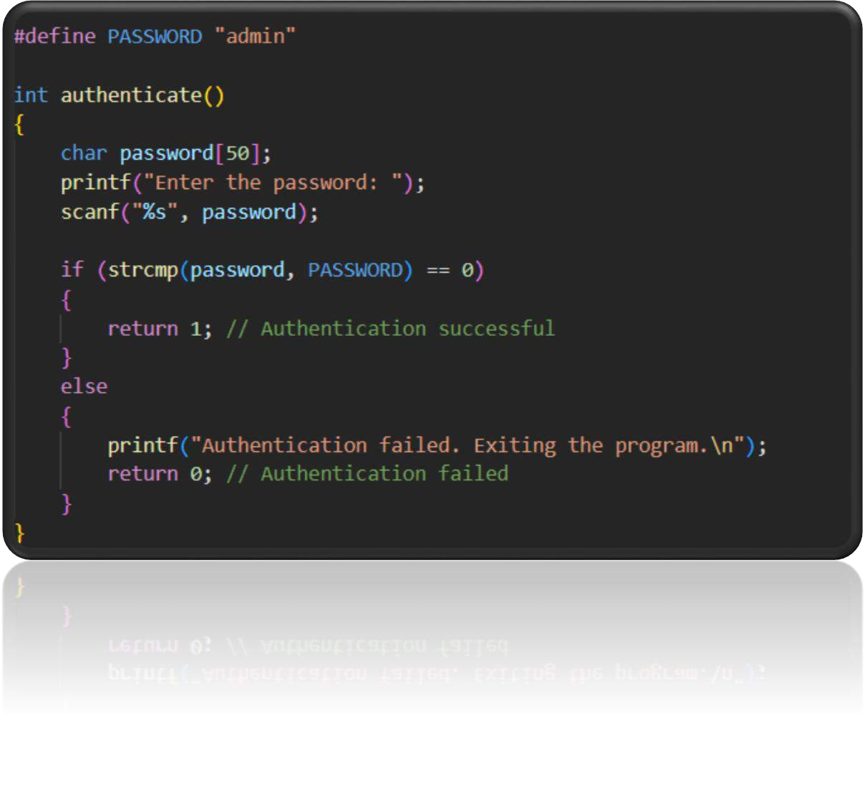

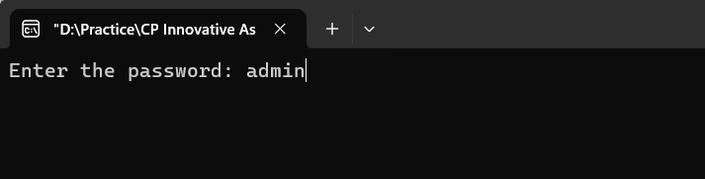
CODE (I/O & O/P)
1. Authentication:
The program starts with an authentication process where the user needs to enter a password ("admin") to access the diary functionalities.
If the authentication fails, the program exits.

Slide 6
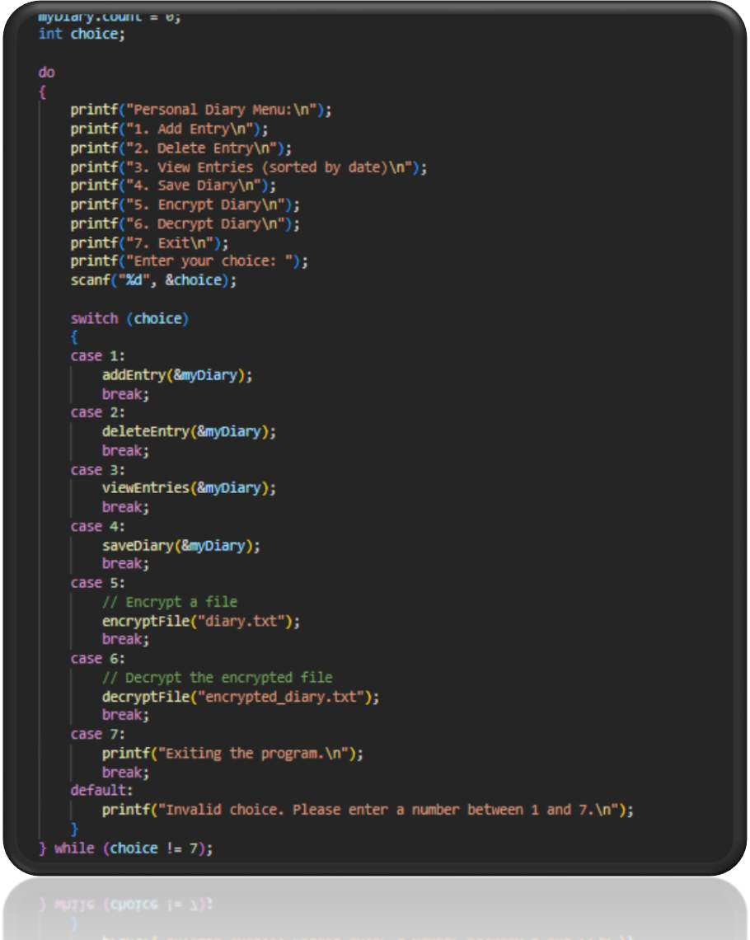

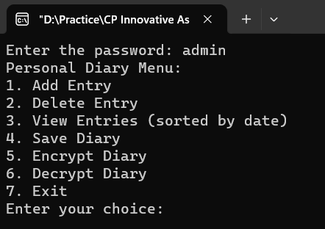
CODE (I/O & O/P)
Menu Driven Interface:
The main functionality is presented through a menu- driven interface, where the user selects options by entering corresponding numbers.
The menu includes options for adding entries, deleting entries, viewing sorted entries, saving the diary, encrypting, decrypting, and exiting the program.

Slide 7
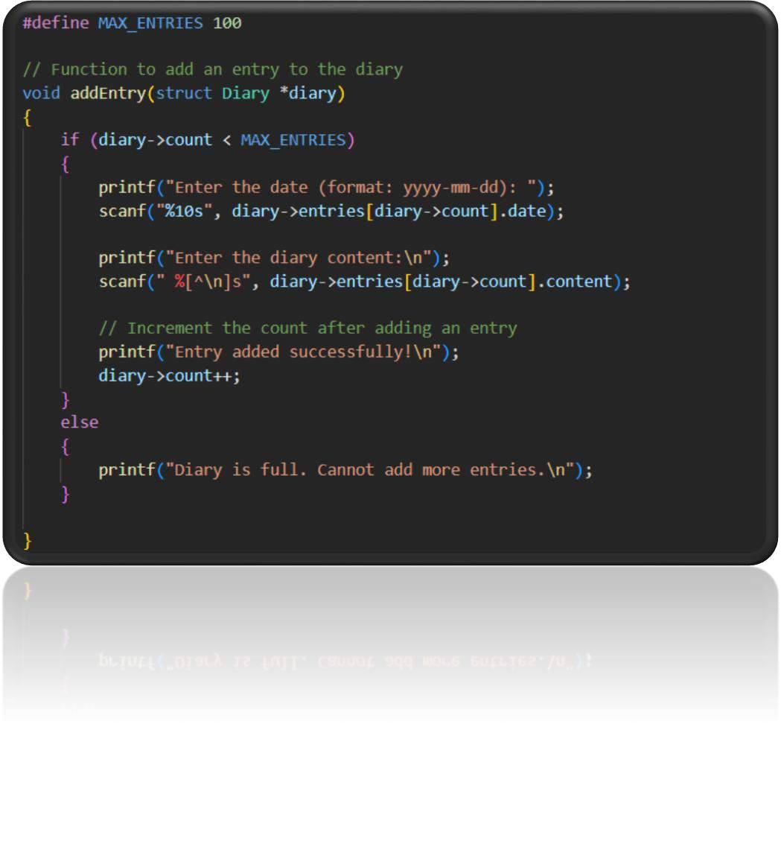

CODE (I/O & O/P)
Diary Entry Management:
Users can add diary entries, providing the date (formatted as "yyyy-mm-dd") and content.
Entries are stored in an array of structures (`struct DiaryEntry`) within a `struct Diary`.
The diary has a maximum capacity defined by `MAX_ENTRIES`.

Slide 8
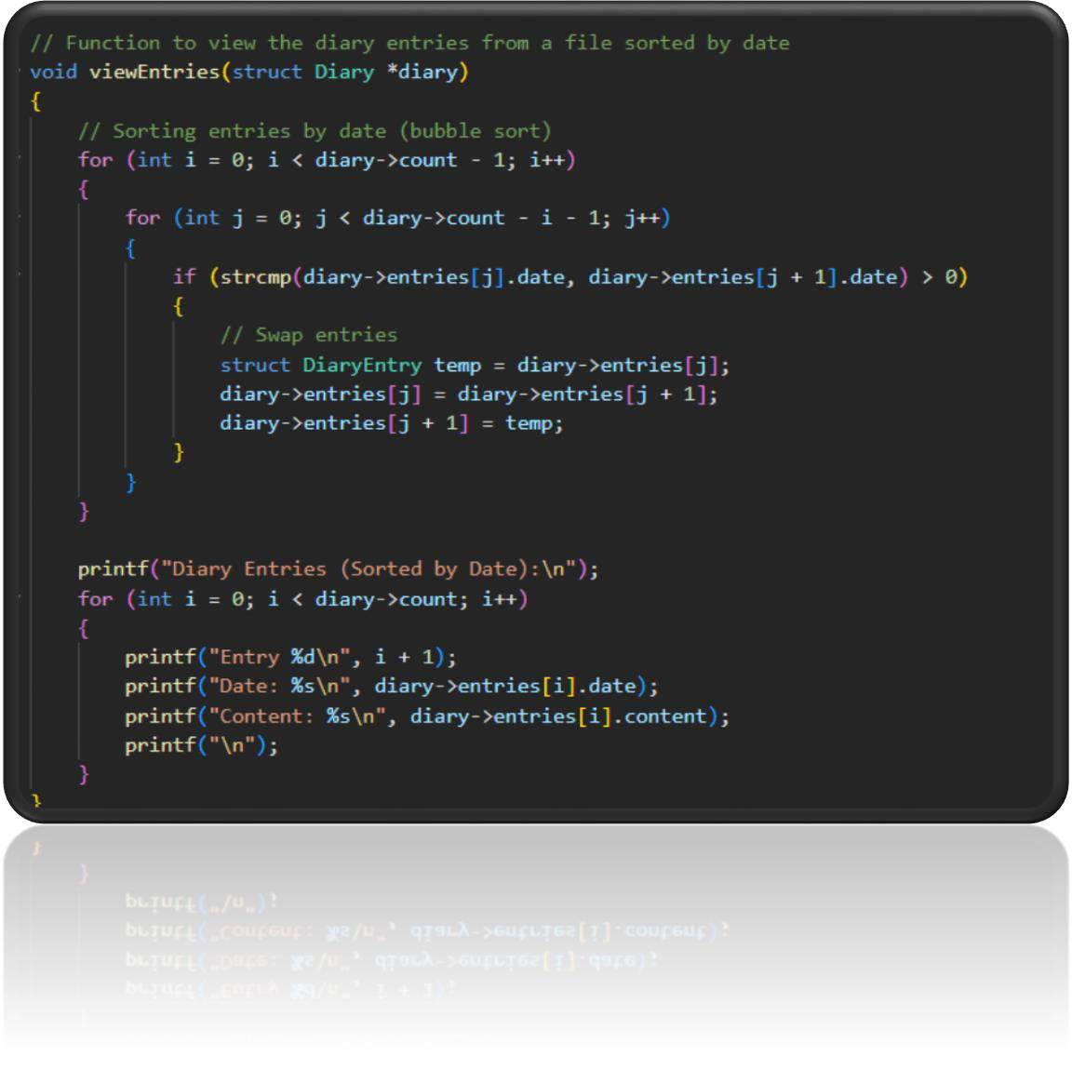

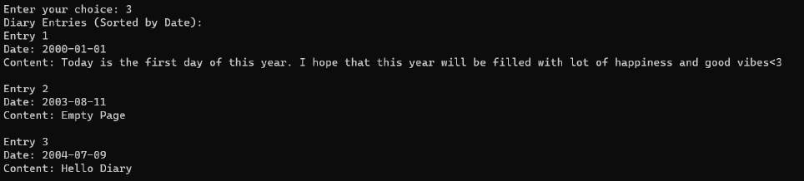
CODE (I/O & O/P)
View Entries (Sorted by Date):
Users can view the diary entries
sorted by date.
The entries are sorted using a simple bubble sort algorithm before displaying

Slide 9
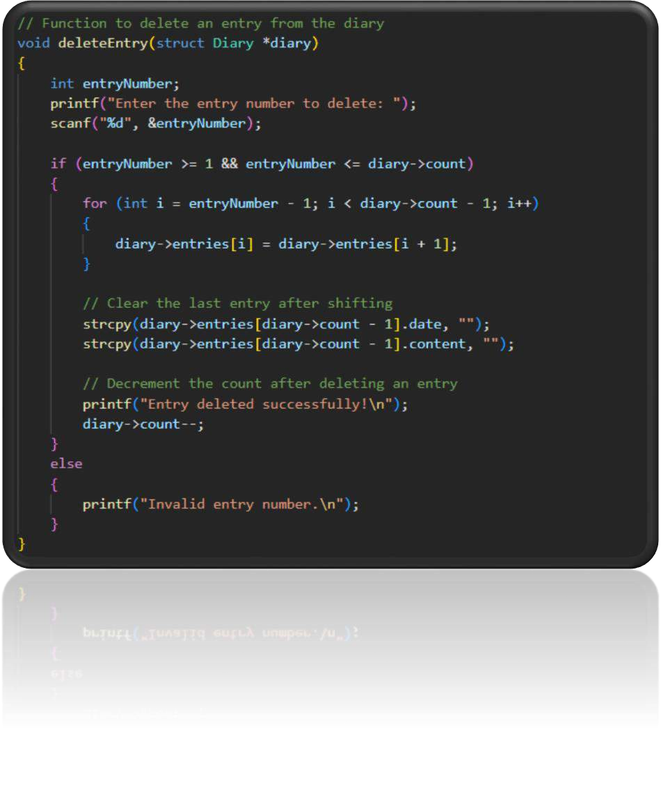



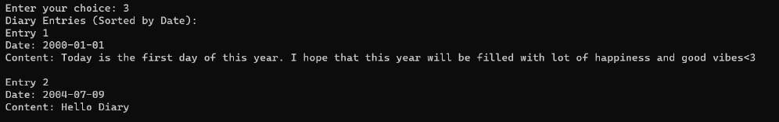
CODE (I/O & O/P)
Diary Entry Deletion:
Users can delete a diary entry by
specifying the entry number.
The specified entry is removed, and the array is adjusted accordingly.

Slide 10
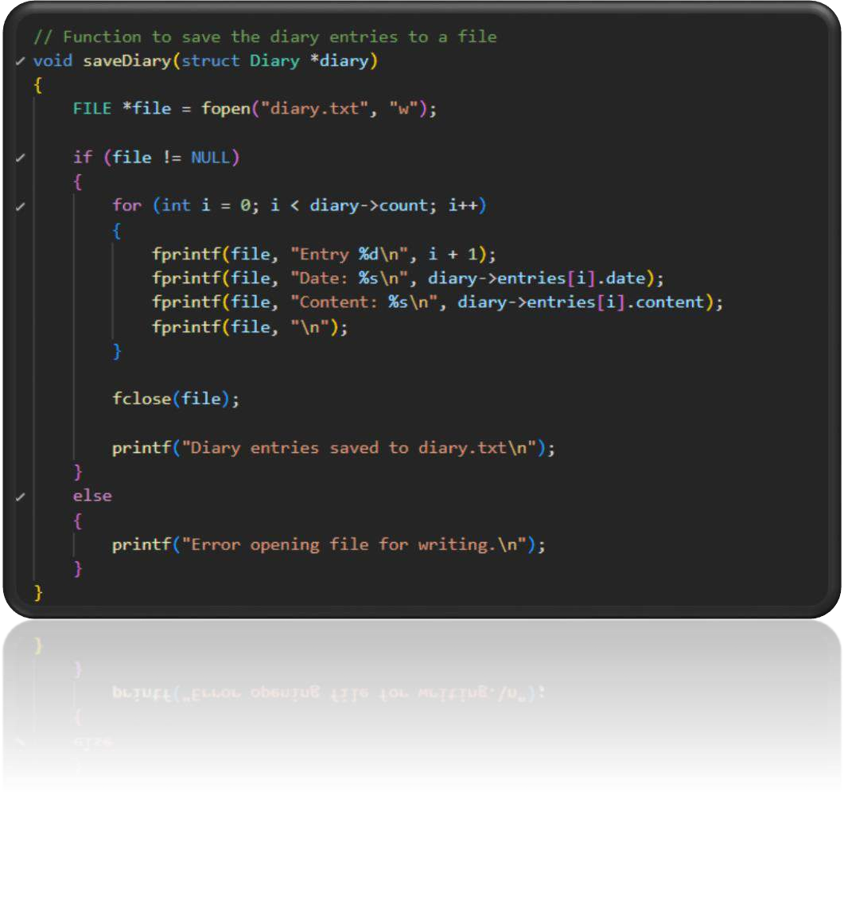
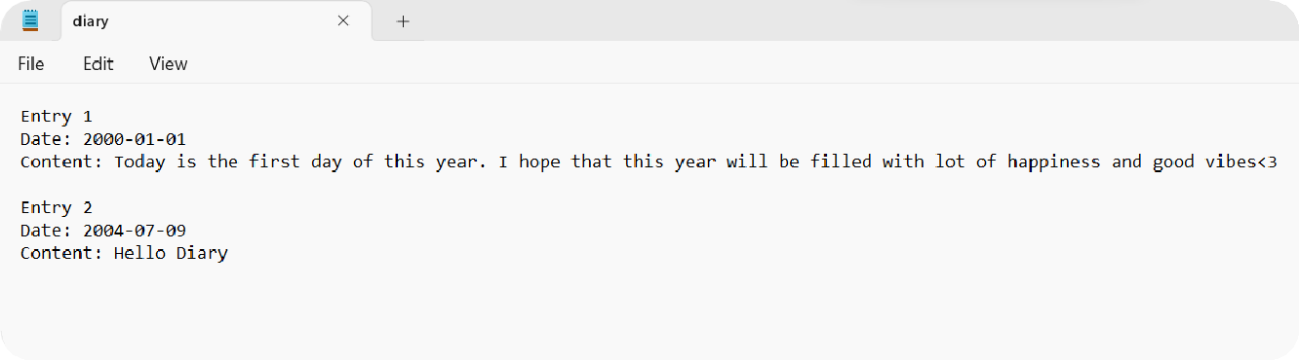
CODE (I/O & O/P)
Save Diary:
Users can save the diary entries to a
file named "diary.txt".
The entries are saved in a human- readable format with each entry's number, date, and content.

Slide 11
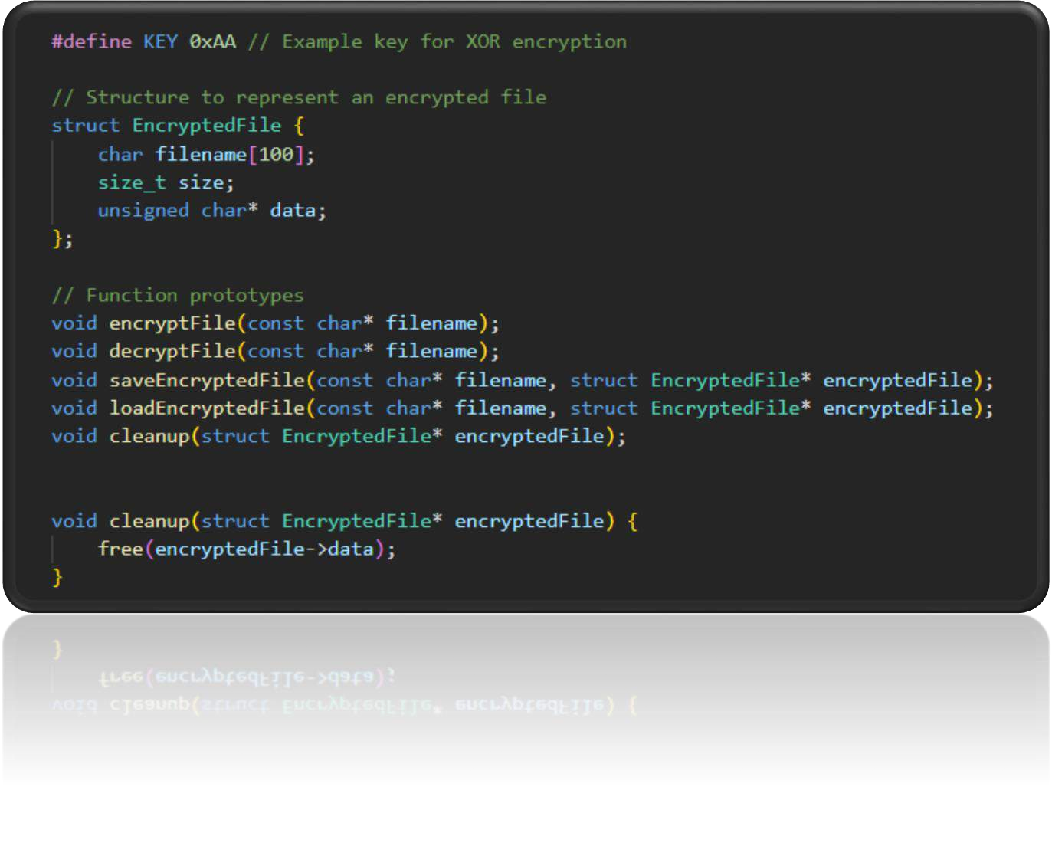
CODE (I/O & O/P)
Encryption & Decryption:
The program provides options to encrypt and decrypt the diary file using a simple XOR based encryption.
The encryption and decryption key is represented by the `KEY` variable (set to `0xAA`).

Slide 12
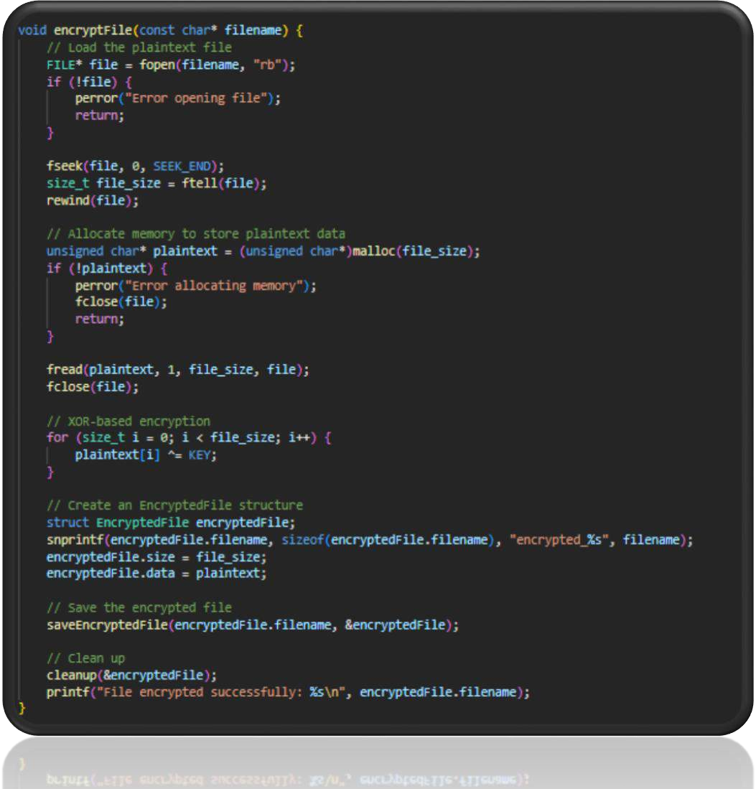
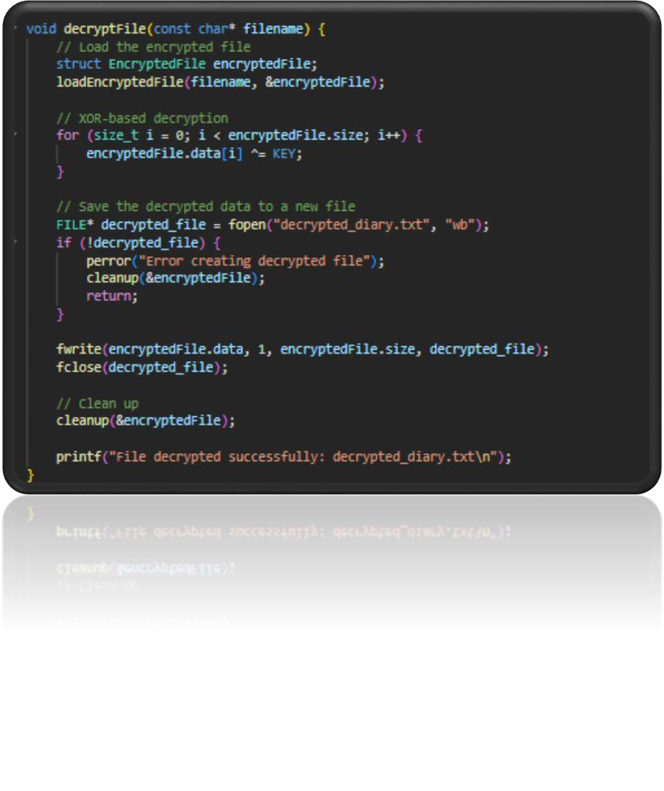
CONTD.

Slide 13
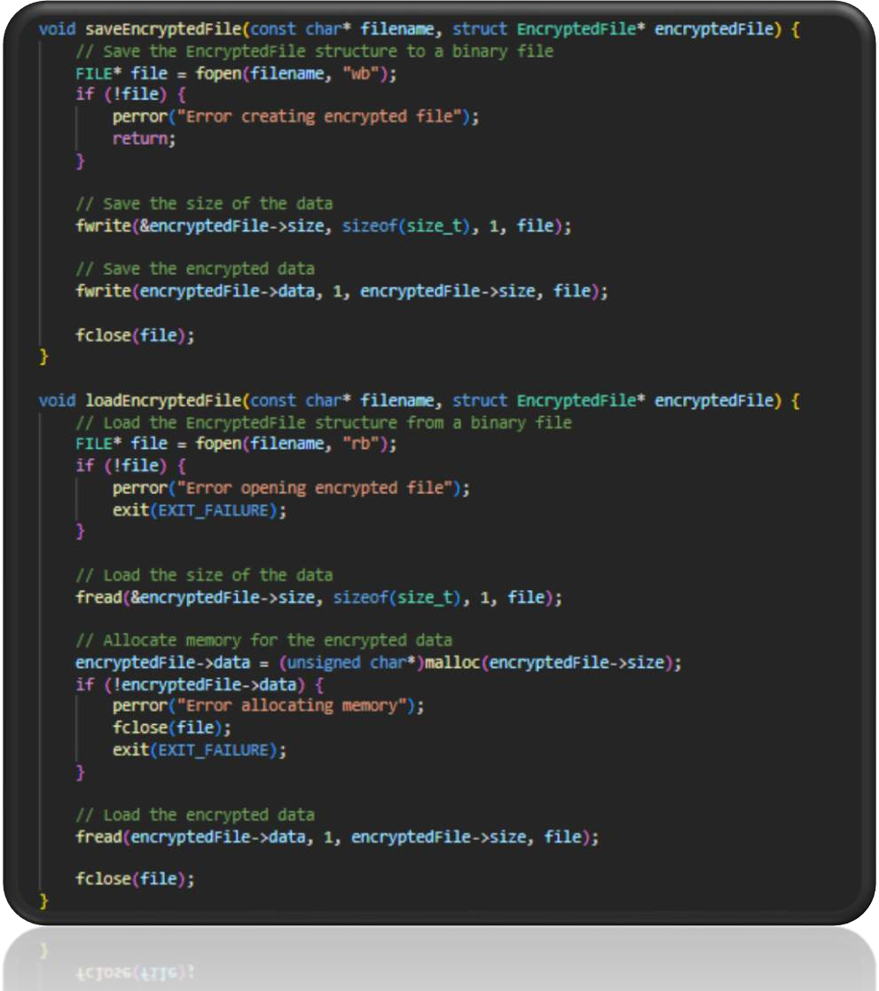
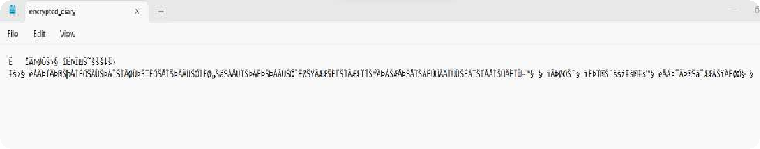

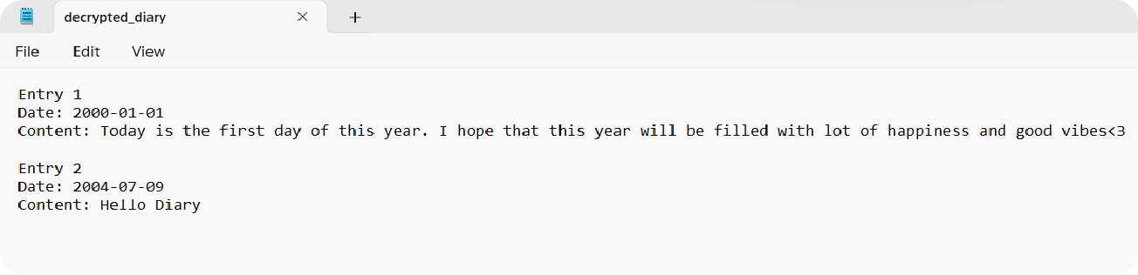
CONTD.

Slide 14
THANK YOU ☺

